Slide 1
Boost Regulator Circuit
Drew Headrick Assignment 5.2: Circuit Card Inquiry Lab

Slide 2
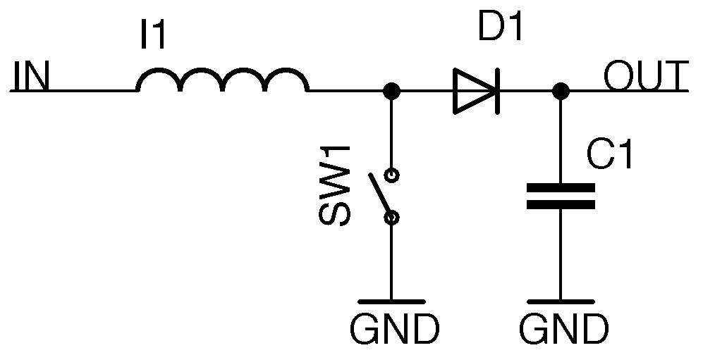
Function
Inductor builds up energy as the switch closes
Switch opens, the inductor builds voltage necessary to push past diode
Output voltage becomes noticeably higher than input voltage
Diode
Inductor
Capacitor
Switch
Notes:
The presented boost regulator functions as such: with the switch SW1 closing the circuit the inductor begins to produce a magnetic field, this field stores energy within it. As the switch opens the circuit back up the voltage of this charge within the inductor’s field begins to grow, it does this until it reaches the point it is able to push through the diode ( which is seemingly functioning as a voltage regulator in this circuit) and then it flows through to the output, capacitor, and thus eventually to ground. This results in the output voltage of the circuit climbing higher than the input voltage. This is primarily because inductors resist change, if the current starts flowing, an inductor wants to keep it flowing. Thus until the energy of the circuit is spent completely the inductor will build voltage and dump its remaining energy through the circuit to the best of its ability.

Slide 3
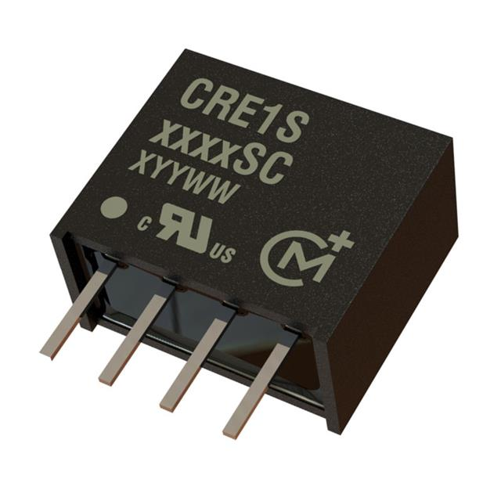
Usage
Voltage stepping is valuable for consumer electronics
Both DC-DC and AC-DC voltage stepping
Used for appliances, automobiles, and power amplification
Notes:
Boost regulator circuits, also known as boost converters, serve a number of purposes within electronic components. One of the common uses is for DC-DC voltage stepping, particularly in battery powered electronics where high voltages from the internal power supply are uncommon but many components within might require it. Thus voltage stepping with boost converters is utilized to a great degree within the consumer electronics industry. However they can also be found quite often for many purposes including power amplification, the automotive industry, or even in heaters all of which have components requiring high voltages which might not be provided initially from the power supply. Boost converters are also utilized in AC-DC voltage stepping, inductors and capacitors working to regulate both the frequency and the output voltage.

Slide 4

Advantages
Essential to the functioning of many portable electronics
Without it many wireless devices would not be able to function as is
Notes:
Allows portable electronics with limited voltage to function with components with much higher limits to voltage. Some examples of high voltage applications within portable devices include RF transceiving, which is vital to many of the wireless electronics most people utilize every day. Without the capability of voltage stepping many of these electronics would have severely limited applications, or would require much larger power supplies to provide the voltage necessary for many of their pertinent functions. Due to their use of inductors it also means that these circuits resist change, and as such if something were to go wrong with the electronics and a surge of power were to flow through the boost regulator the inductor within the circuit may help to regulate it, as it already functions as a short-circuit within the system. Many such regulators come with features to protect against short-circuits and other common issues.

Slide 5
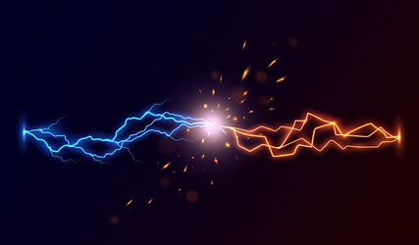
Disadvantages
Discontinuous flow of power
Low efficiency
Unable to step down Voltage
Notes:
Power flow to devices becomes discontinuous when these are utilized. As mentioned previously using inductors in this way leads to basically emulating a short circuit within your electronic component, thus it needs to be regulated properly to prevent this causing any issues. Overall efficiency of these circuits is also fairly low in comparison to some of the variations and other components. Proper control and regulation of such simple circuits is surprisingly difficult a majority of the time. This version also cannot step voltage down, which limits it from many more applications.

Slide 6
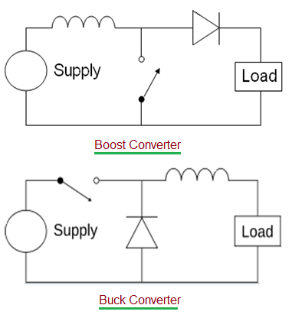
Variations
Buck Converters
Flyback Converters
Forward Converters
Notes:
There are many variations of this kind of circuit, including those capable of more AC-DC conversion. Buck converters are highly similar to the boost converters shown previously, although they differ in that they allow step-down of voltage instead of stepping it up, which opens them to a number of alternative applications typical boost converters are incapable of. Another example of a variant type of converter are flyback converters, which use transformers and store energy within, utilizing the air gaps they provide. Forward converters being a higher efficiency variation of flyback converters which use a more complex architecture. Each of these variations come with their own applications (although flyback and forward converters can be used in place of each other at times) and can sometimes make up for applications in which a traditional boost converter lacks.

Slide 7
References
DigiKey’s North American Editors. (2018, January 10). Generating a high DC output voltage from a low input supply. DigiKey. https://www.digikey.com/en/articles/generating-a- high-dc-output-voltage-from-a-low-input-supply
José Prieto, M. Á., Nuño García, F., Martín Ramos, J. A., Villegas Saiz, P. J., Muñiz Sánchez, R., & Díaz, J. (2023). Digital Controllers for electrical engineering (microcontrollers, DSP, FPGA): Main peripherals. Encyclopedia of Electrical and Electronic Power Engineering, 70–91. https://doi.org/10.1016/b978-0-12-821204-2.00011-8
[Phreestyle Physics]. (2016, April 10). 23.09 Energy Stored in an Inductor [Video]. Youtube. https://youtu.be/1EPSYNY22ys?si=qdPQz7hNZVWJBk9Y
Storr, W. (2022, August 2). AC-DC converters including Buck, boost and flyback. Basic Electronics Tutorials. https://www.electronics-tutorials.ws/connectivity/ac-dc-converters.html

